Slide 1
Introduction to Digital Electronics

Slide 2
Tutorial
Lecture delivered by:
Deepak V.

Slide 3
Objectives
At the end of this lecture, student will be able to:
Solve the problems on various radix conversion

Slide 4
Topics
Octal to Binary conversion
Octal to Hexadecimal conversion
Octal to Decimal conversion
Decimal to Octal conversion
Decimal to Binary conversion
Decimal to Hexadecimal conversion
Binary to Octal conversion
Binary to Hexadecimal conversion
Binary to Decimal conversion
Hexadecimal to Octal conversion
Hexadecimal to Binary conversion
Hexadecimal to Decimal conversion

Slide 5
Exercise – Convert ...
Decimal | Binary | Octal | Hexa- decimal
33
 | 1110101
 |  | 703
 |  |  | 1AF
Don’t use a calculator!

Slide 6
Exercise – Convert ...
Decimal | Binary | Octal | Hexa- decimal
33 | 100001 | 41 | 21
117 | 1110101 | 165 | 75
451 | 111000011 | 703 | 1C3
431 | 110101111 | 657 | 1AF

Slide 7
Common Powers (1 of 2)
Base 10
Power | Preface | Symbol
10⁻¹² | pico | p
10⁻⁹ | nano | n
10⁻⁶ | micro | μ
10⁻³ | milli | m
10³ | kilo | k
10⁶ | mega | M
10⁹ | giga | G
10¹² | tera | T
Value
.000000000001
.000000001
.000001
.001
1000
1000000
1000000000
1000000000000

Slide 8
Common Powers (2 of 2)
Base 2
Power | Preface | Symbol
2¹⁰ | kilo | k
2²⁰ | mega | M
2³⁰ | Giga | G
Value
1024
1048576
1073741824

Slide 9
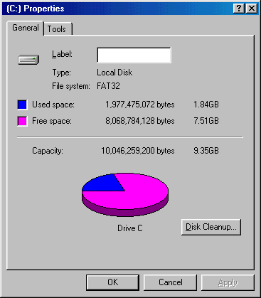
Example
In the lab… 1. Double click on My Computer 2. Right click on C: 3. Click on Properties
/ 2³⁰ =

Slide 10
Exercise – Free Space
Determine the “free space” on all drives on a machine in the lab
Drive | Free space
 | Bytes | GB
A:
C:
D:
E:
etc.

Slide 11
Summary
All types of radix conversions requires its own techniques

